Slide 1
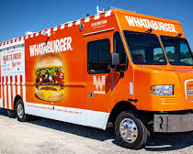
Food Truck Safety
Fire and Life Safety Inspector
Josh Adkins

Slide 2
Food Truck Safety Agenda
Definition of food trucks and their history
Dangers of food trucks
Local ordinance
NFPA codes and standards
Proposed inspection plans

Slide 3
What is a food truck?
Technically defined as a mobile food dispensing vehicle, a food truck is defined by The Florida Administrative Code 61C-1.002 as any vehicle that is a public food service establishment and that is self-propelled or otherwise movable from place to place.
Mobile food dispensing vehicles are completely enclosed and operate from a commissary or service base. They have permanent, self-contained utilities including power, water, and waste disposal.

Slide 4
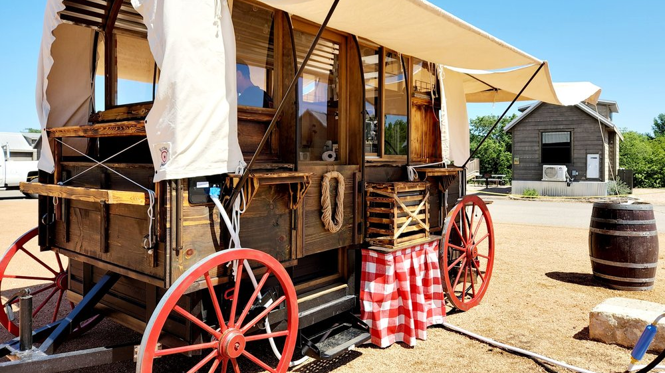
History of food trucks

Slide 5
Chuck Wagons (Post-Civil War Era):
Originating in the years after the Civil War, chuck wagons were mobile kitchens that followed trail-driving cowboys in the Wild West.
Chuck wagons were specialized for cooking, with designated areas for pot storage, food preparation, and washing up.
Pushcarts (Late 19th to Early 20th Century):
Pushcarts served urban workers in larger cities like New York and Chicago.
Although lacking the ability to cook food, pushcarts provided simple lunches such as meat pies, fruits, and sandwiches.
Advent of the Automobile (1950s):
In the 1950s, modified ice cream trucks were among the first businesses to take to the streets in vehicles resembling modern food trucks.
These trucks featured recorded jingles and painted signs, setting the stage for the future of mobile food businesses.
Transformation and Rise in Popularity (Early 2000s):
By the early 2000s, the negative associations with food trucks had largely disappeared.
Shiny, new parks were constructed in major cities to accommodate food trucks, and festivals dedicated to celebrating them emerged.
The perception of food trucks shifted from being associated with grime and grit to being recognized as part of a vibrant and diverse food scene.

Slide 6
Adopting into code
While modern food trucks contain new and evolved technology, the need for fire codes and standards became crucial as dangers evolved.
In 2018, NFPA 1 (7th edition) adopted food trucks into chapter 50, as they fell under the code of "Commercial Cooking Equipment".
NFPA 1 chapter 50.8 is specifically designed to address "Mobile and Temporary Cooking Operations".

Slide 7
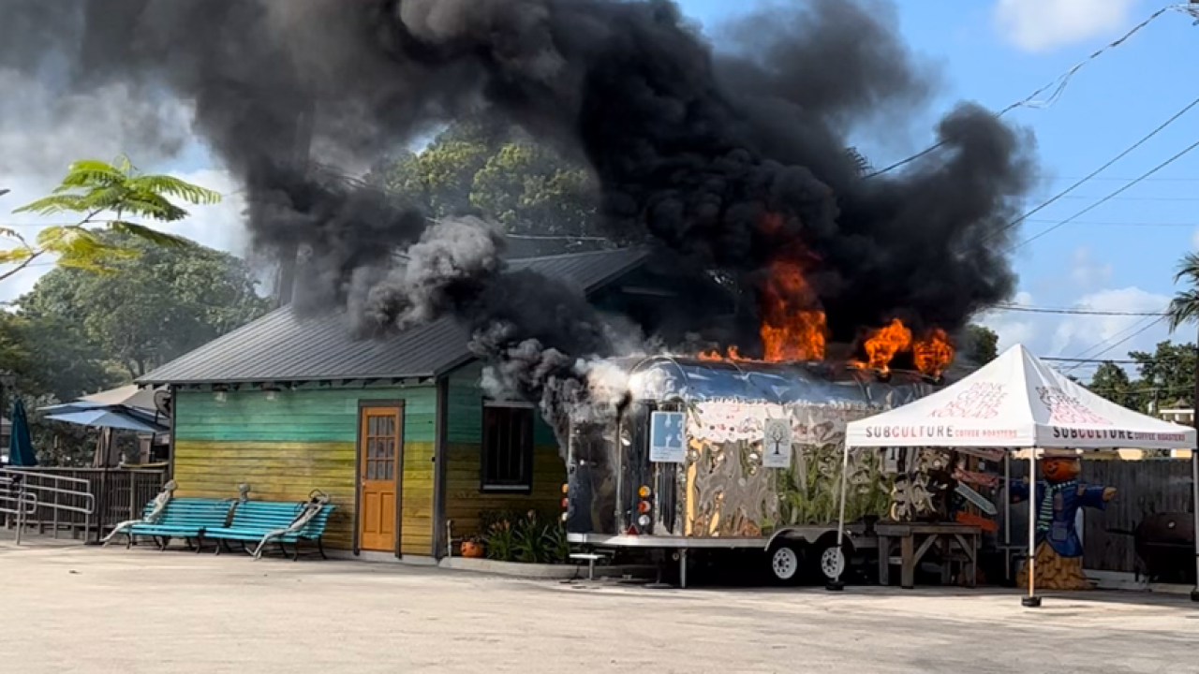
Dangers of food trucks

Slide 8
Potential Dangers of food trucks
Electrical wiring
Cooking equipment malfunctions
Gas leaks
Oil spills
Improper handling of flammable materials.
Inadequate ventilation leading to carbon monoxide buildup
Regular maintenance, proper safety protocols, and adhering to fire safety regulations can help prevent such incidents and ensure the safety of both food truck operators and customers.

Slide 9
Are food trucks dangerous?

Slide 10
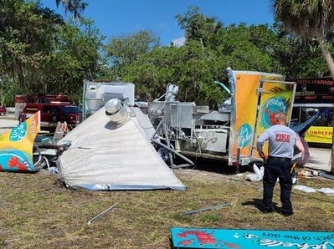
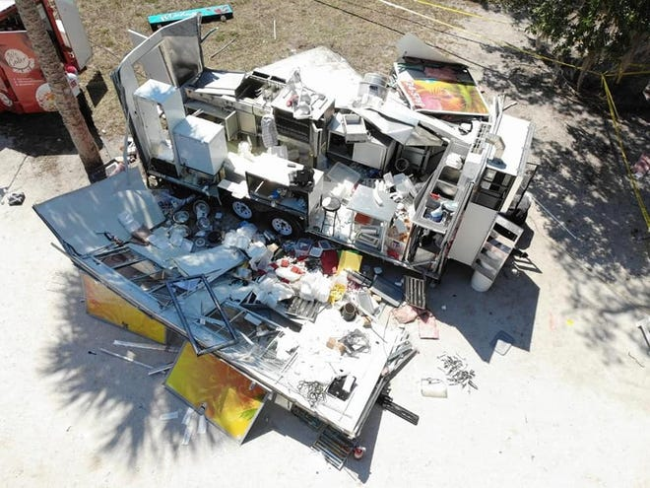
woman hospitalized with severe burns received after her food truck exploded
May 14, 2022, in Riverside Park before the Vero Beach Seafood Festival opened, officials said they've begun their investigation into the blast's cause and into who was responsible for what they described as a "preventable" accident.
Gilbert told police around 8 a.m. “she could smell a very strong odor of gas” from the area of the trailer and sent a worker to find the source. The event worker told police in the report he talked with the owner of the trailer and said one of the trailer’s two outside propane tanks “felt empty.”
“He then walked away and a short time later he heard the explosion,” Officer Richard Chimenti stated.
The business passed its most recent inspection March 24 without any violations, according to the department's website, and received its food license the following day, said Patrick Fargason, DBPR deputy communications director.
Arwood, Corey. “Food Truck Owner Critical 6 Days after Explosion at Vero Beach Festival; Attorneys Probe Cause.” Treasure Coast, Treasure Coast Newspapers, 20 May 2022,www.tcpalm.com/story/news/local/indian-river-county/2022/05/20/lawyers-woman-injured-food-truck-explosion-vero-beach-seafood-investigation-no-criminal-charges/9853671002/.

Slide 11
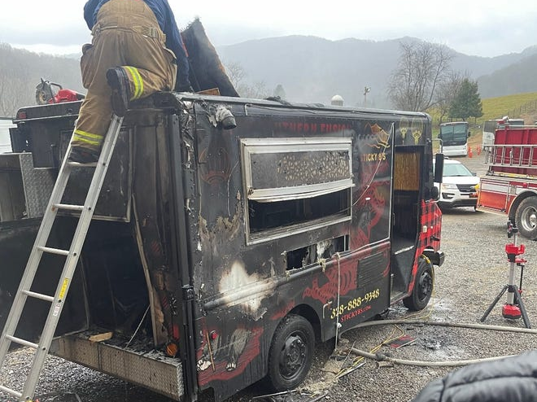
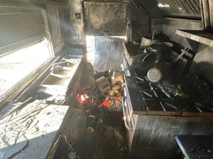
Food truck destroyed after early morning fire
Early morning, on Dec. 9, 2023, the husband and wife woke up to calls from people alerting them of a fire that would damage their food truck beyond repair.
Ashley Gainey said on Friday night, Dec. 8, she and her husband worked an event and, as normal, stored the food truck at a commissary kitchen, plugging it into the building to charge.
Firefighters arrived on the scene to find the vehicle “fully engulfed by fire” with flames going up 3 to 4 feet in the air, he said.
Kennell, Tiana. “Food Truck Destroyed after Early Morning Fire, Owners Consider Future.” The Asheville Citizen Times, Asheville Citizen Times, 13 Dec. 2023, www.citizen-times.com/story/news/local/2023/12/13/sticky-8s-food-truck-destroyed-by-fire-community-offers-support/71880679007/.

Slide 12
Local fire ordinance section 15: Mobile food dispensing vehicle(MFDV)
15.1 Mobile and/or temporary cooking operations shall be inspected prior to operation at each event/location within the district.
15.1.1 Cooking equipment used in mobile and/or temporary cooking concessions, such as trucks, trailers, and/or buses shall comply with NFPA 1, NFPA 10, NFPA 96, FFPC, and/or FAC 61C.
15.1.2 Each vendor shall be properly licensed by the Florida Department of Business and Professional Regulation (DBPR), Division of Hotels and Restaurants and/or the Florida Department of Agriculture, Division of Food Safety.

Slide 13
FFPC 1:50.8 requirements
1:50.8 Mobile and Temporary Cooking Operations
50.8.4.1 Temporary cooking operations conducted in tents shall comply with NFPA 102 and Chapter 25, Grandstands, Seating & Membrane Structures.
50.8.5.1 Electric generator and internal combustion power sources used for mobile or temporary cooking shall comply with 50.8.5
50.8.7.1 LP-Gas systems for mobile cooking operations shall comply with NFPA 58
50.8.7.3.2 The LP-Gas leak detection system shall be tested monthly
50.8.7.3.5 LP-Gas leak detection testing shall be documented and the documentation be held in the mobile or temporary unit and made available to the AHJ upon request.

Slide 14
NFPA 96 requirements
96:17.2 Check that there is a 10 ft clearance away from buildings, structures, vehicles, and any combustible materials.
96:10.1.2 Check that appliances using combustible media are protected by an approved fire extinguishing system.
96:10.9 Verify portable fire extinguishers have been selected and installed in kitchen areas in accordance with NFPA 10.
96:17.8.1 Ensure all electrical appliances, fixtures, equipment, and wiring comply with NFPA 70.
96:12.4 Cooking equipment including cooking ventilation system, cleaned regularly by removing grease.
96:17.10 Ensure workers are trained in the following:
Proper use of portable fire extinguishers and equipment
Method of shutting of fuel source
Procedure for notifying local fire department
Procedure for how to perform simple leak tests on gas connections

Slide 15
NFPA requirements

Slide 16
Proposed Inspection Plans
MOBILE FOOD VEHICLE INSPECTION CHECKLIST

Slide 17
Proposed Inspection Plans

