Slide 1
Jimbo’s Gumbo and Grill
Board of Appeals
February 29, 2024

Slide 2
Overview
Background of Jimbo’s Gumbo and Grill
Definition - Assembly Occupancy
Supporting Documents
  2023 Florida Statutes Chapter 633 – Fire Prevention & Control
  Manatee County Fire Ordinance 2024-01
  Florida Fire Prevention Code (FFPC) 7th Edition - NFPA 101 – Life Safety Code
Closing
Questions

Slide 3
Background of Jimbo’s
Jim Beau Jr., owner of Jimbo’s Gumbo and Grill, is here today appealing his most recent fire and life safety plans review requiring the installation of a new NFPA 13 compliant system.
Existing Assembly – Occupant load: 164
Current square footage: 9200 sq ft.
Proposed addition: 600 sq ft.
Totaling: 9800 sq ft.

Slide 4
Definition
Assembly Occupancy
FFPC 101: 3.3.198.2 - An occupancy (1) used for the gathering of 50 or more persons for deliberation, worship, entertainment, eating, drinking, amusement, awaiting transportation, or similar uses; or (2) used for a special amusement building, regardless of occupant load.
Occupancy types are either considered “existing” or “new”.

Slide 5
Supporting Documents
2023 Florida Statutes Chapter 633 – Fire Prevention & Control
What gives the fire district the authority to create its own local ordinance?
Minimum Fire Safety Standards
  633.208 (3) – Such code shall be a minimum code, and a municipality, county, or special district with fire safety responsibilities may adopt more stringent fire safety standards.

Slide 6

Supporting Documents cont.
Local Ordinance
What requires Jimbo’s Gumbo and Grill to have a sprinkler system in accordance with NFPA 13.
Manatee County Fire Ordinance, which is recognized and approved by the state of Florida, is designed to be more stringent than the Florida Fire Prevention Code (FFPC).
Section 6: Application - 6.1 The provisions of this Code shall apply to all buildings, structures, vehicles, marine vessels, premises, and conditions within this jurisdiction. The provisions of this Code shall apply equally to existing as well as new buildings (unless specifically noted in this Code)…

Slide 7
Supporting Documents cont.
Local Ordinance
Section 7: Authority – Local Ordinance
  7.1 This Code Shall be administered and enforced by the Fire Official designated by the governing authority of this jurisdiction as having this responsibility. They shall meet those qualifications as may be set forth by the jurisdiction as being necessary to effectively administer this Code.
  7.2 This act shall be deemed an exercise of the enforcement power of Manatee County Fire Rescue for the preservation and protection of the public health, peace, safety, and welfare, and all provisions of this Code shall be liberally construed for that purpose.

Slide 8


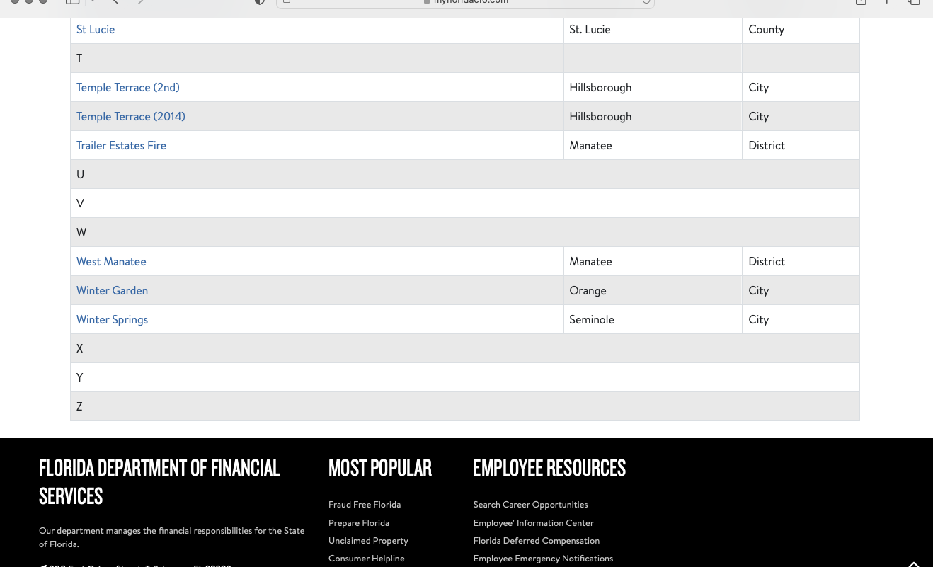
Supporting Documents cont.
Local Ordinance
Local Amendments to the Florida Fire Prevention Code
Posted on the State Fire Marshal’s website
Manatee County Fire Rescue. Manatee District

Slide 9
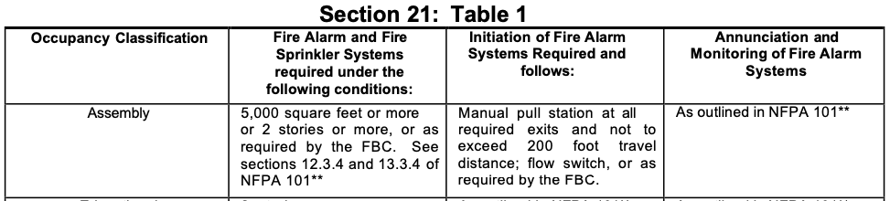
Supporting Documents cont.
Local Ordinance
Local Ordinance, Section 21, Table 1

Slide 10
Supporting Documents cont.
FFPC 101 Chapter 12 – New Assembly
12.3.5 Extinguishment Requirements
  12.3.5.1 (Florida Specific) - Where the occupant load exceeds 100, the following assembly occupancies shall be protected throughout by an approved, supervised automatic sprinkler system in accordance with 9.7.1.1(1):
    (1) Dance halls
    (2) Discotheques
    (3) Nightclubs
    (4) Bars
    (5) Restaurants
    (6) Assembly occupancies with festival seating

Slide 11
Closing
Background of Jimbo’s Gumbo and Grill
Definition - Assembly Occupancy
Supporting Documents
  2023 Florida Statutes Chapter 633 – Fire Prevention & Control
  Manatee County Fire & Rescue Ordinance 2024-01
  Florida Fire Prevention Code 7th Edition - FFPC 101 – Life Safety Code
    Chapter 3 – Definitions
    Chapter 43 – Building Rehab
    Chapter 12 – New Assembly
  The required sprinkler system shall be installed in accordance with NFPA 13

Slide 12
Questions?

