Slide 1
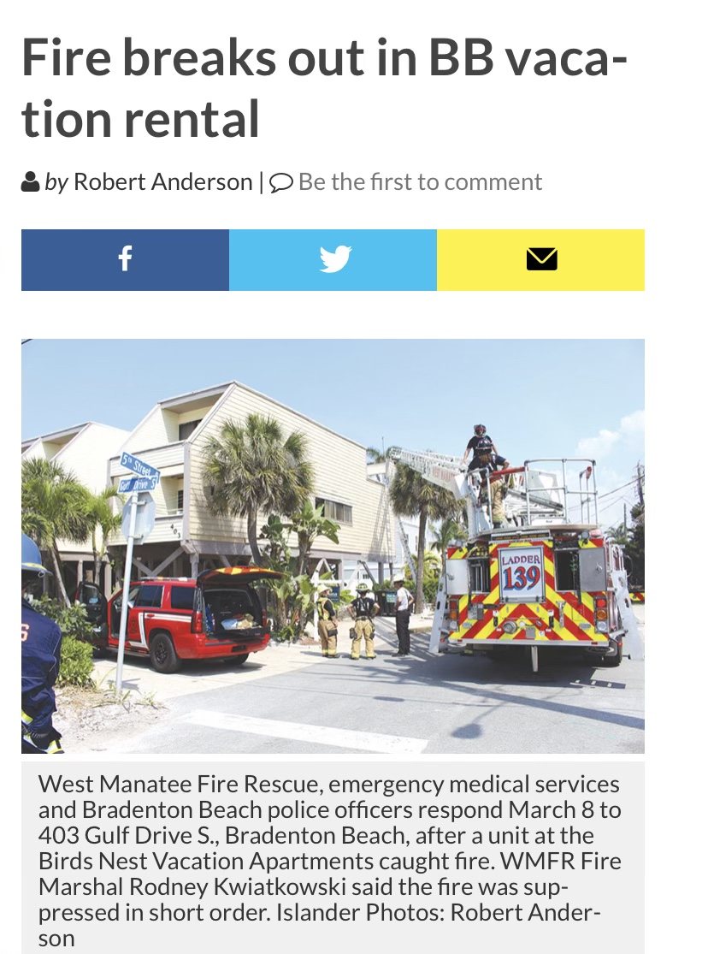

Slide 2
TEMPORARY PUBLIC
LODGING ESTABLISHMENTS
AKA
VACATION RENTALS
“By failing to prepare, you are preparing to fail.”
-Benjamin Franklin

Slide 3
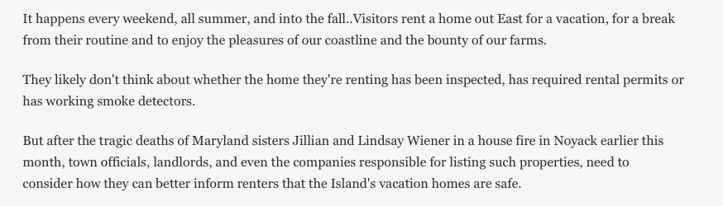

Slide 4
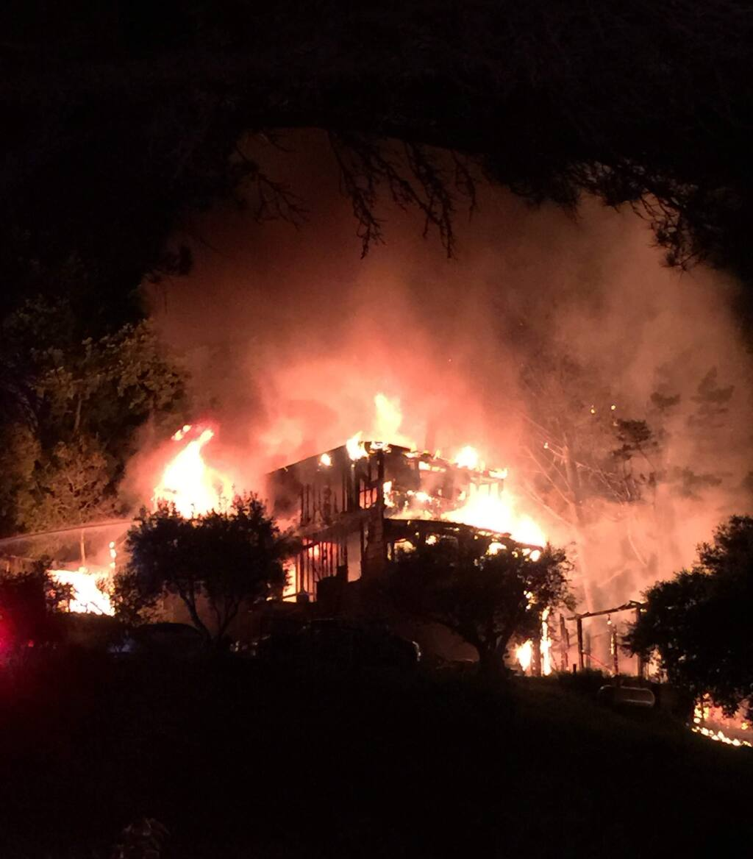
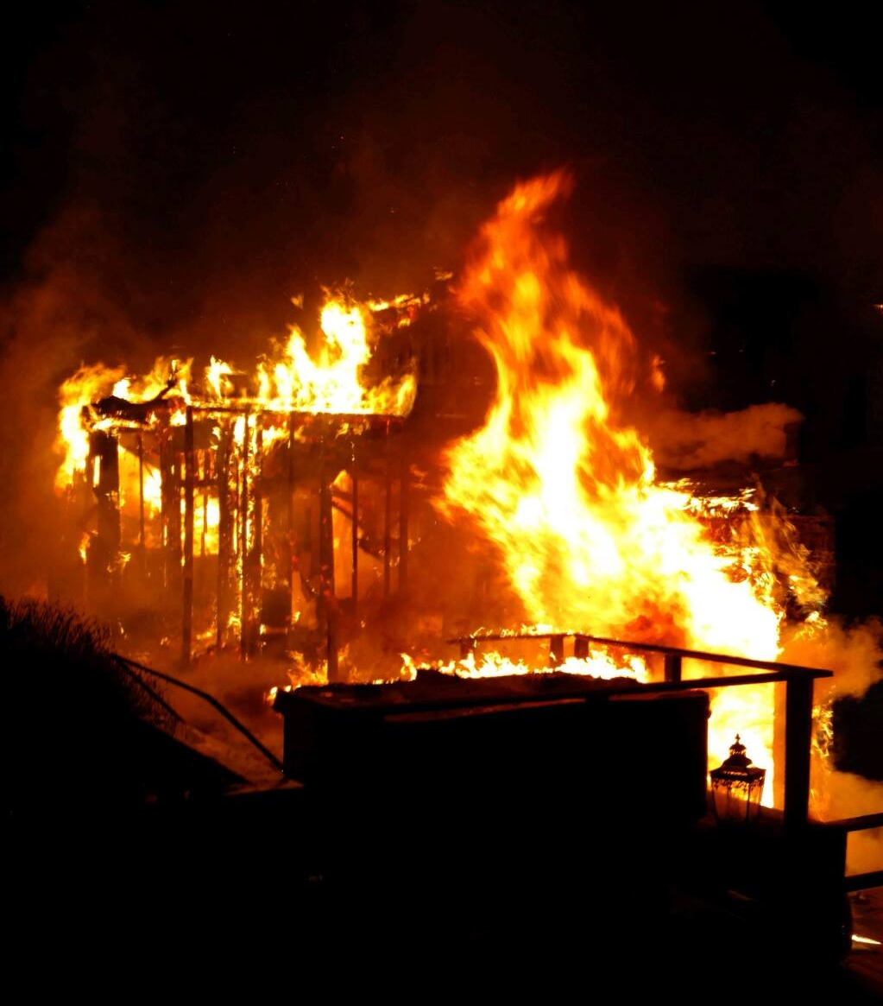
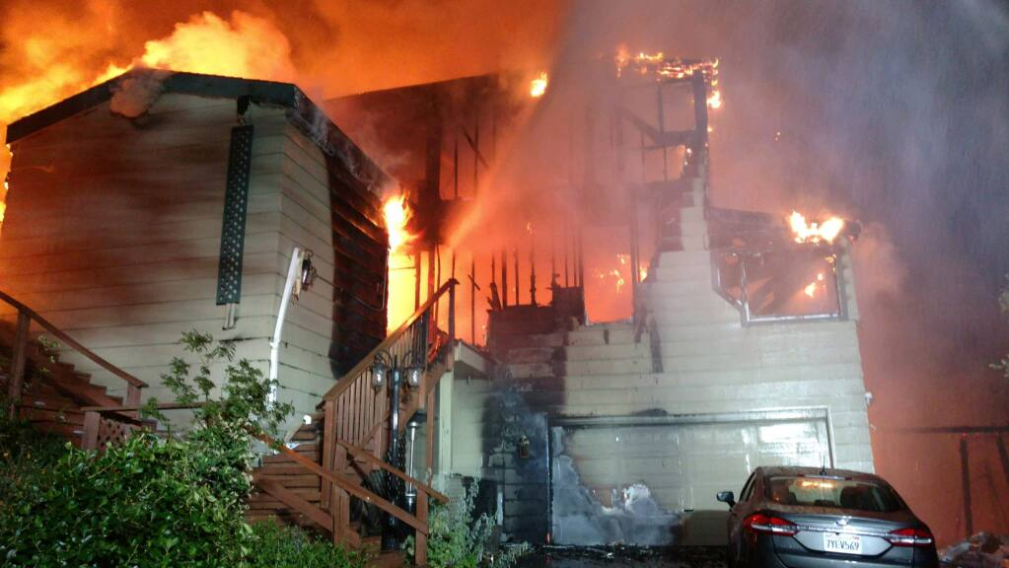


Slide 5
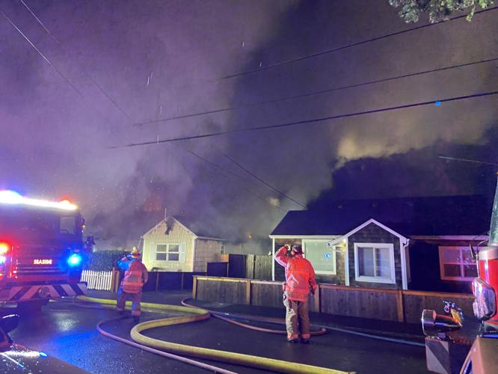
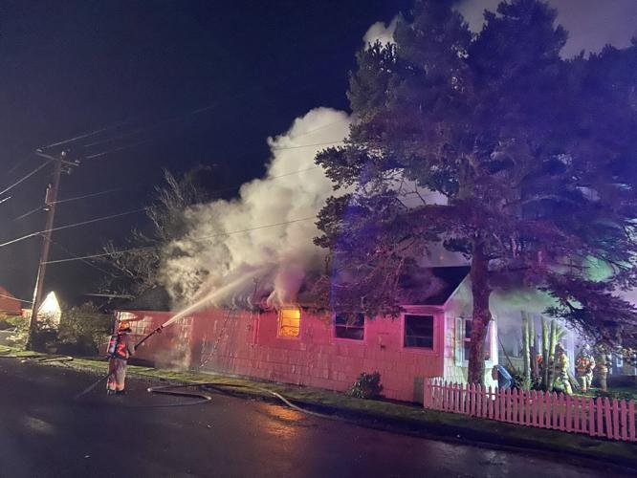


Slide 6

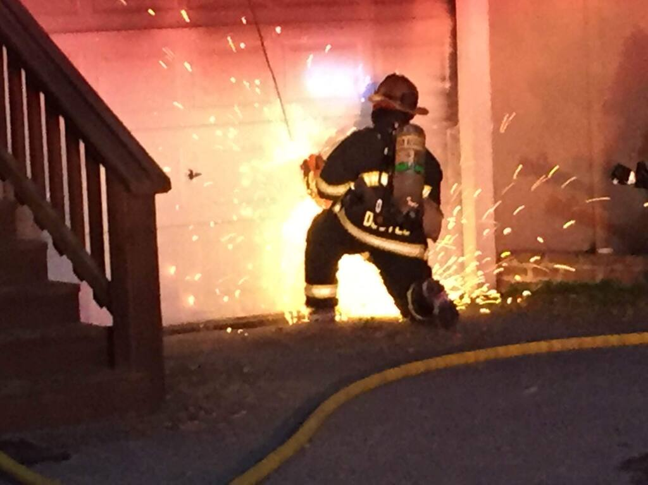
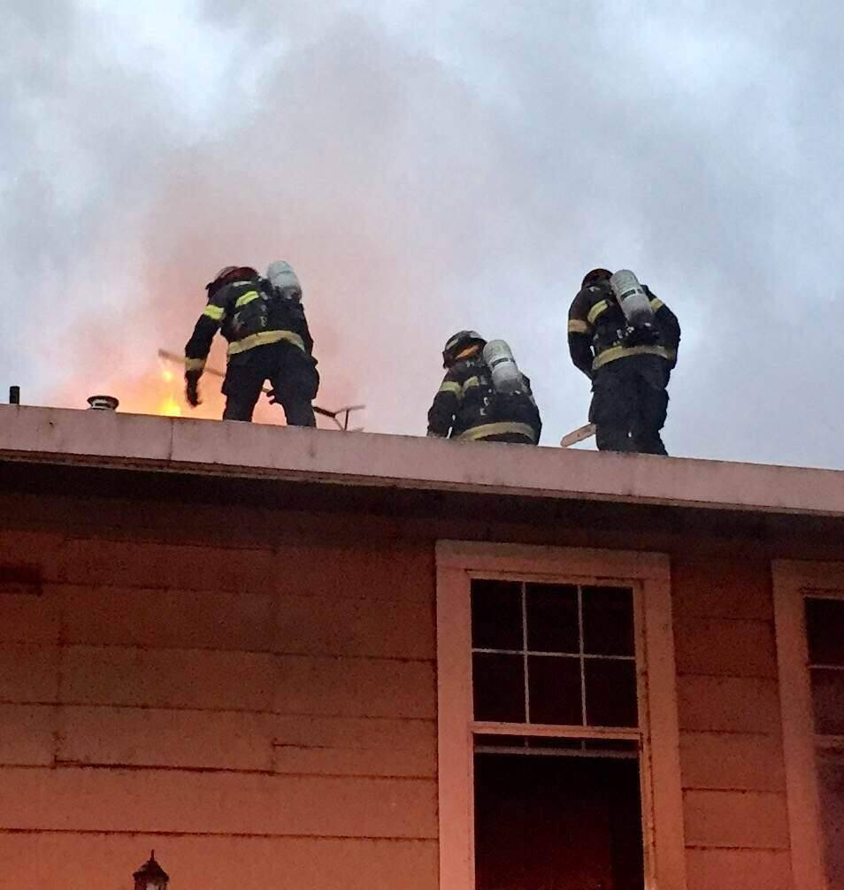
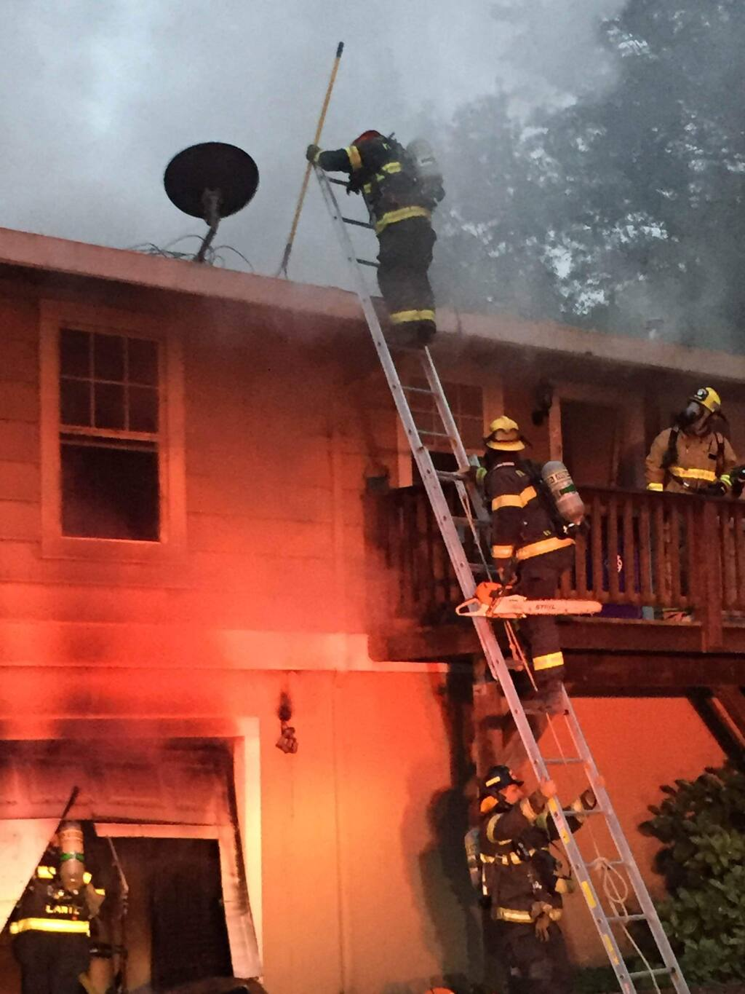


Slide 7
Statistics
73%
In the past 3 years, Anna Maria Island has had eleven structure fires at single family residential occupancies.
Of those eleven, 8 were in vacation rentals.

Slide 8
More Statistics
In 2022, WMFRD had three pediatric near-drownings in single family residences.
Of those three…
100% occurred in TPLEs.

Slide 9
What is a “Vacation Rental”?
1) A public lodging establishment shall be classified as a hotel, motel, non-transient apartment, bed and breakfast inn, or vacation rental if the establishment satisfies the following criteria:
Florida Statute 509.242(1)

Slide 10
What is a “Vacation Rental”?
Florida Statute 509.242(1)(c)
Any unit or group of units in a condominium or cooperative or any individually or collectively owned single family, two family, three family, or four family house or dwelling unit that is also a transient public lodging establishment...

Slide 11
What is a “Transient Public Lodging Establishment”?
Florida Statute 509.013(4)(a)(1)
“Transient public lodging establishment” means any unit, group of units, dwelling, building, or group of buildings within a single complex of buildings which is rented to guests more than three times in a calendar year for periods of less than 30 days or 1 calendar month, whichever is less, or which is advertised or held out to the public as a place regularly rented to guests.

Slide 12
Who Licenses Transient Public Lodging?
Division of Hotels and Restaurants.
Department of Business and Professional Regulations (DBPR)

Slide 13
Are There Any Licensing Exclusions?
Any migrant labor camp permitted by Department of Health (DOH).
Any facility certified or licensed and regulated by the Agency for Healthcare Administration (AHCA).
  Nursing homes
  Daycare Centers
  Assisted Living Facilities (ALF) – Conversions…

Slide 14
Florida Statute 633.206 Uniform Fire Safety Standards
(1)(b) State Legislature mandates Local Fire Jurisdictions protect the health, safety, and welfare of “all new, existing, and proposed… nursing homes, assisted living facilities, adult family-care homes… transient public lodging establishments…”
(2)(b) All such local authorities shall enforce, within their firesafety jurisdiction, the uniform firesafety standards for those buildings specified in paragraph (1)(b)

Slide 15
What Codes Do We Use to Enforce?
  Florida Administrative Code Chapter 69A-43-Uniform Fire Safety Standards for Transient Public Lodging Establishments, Timeshare Plans, And Timeshare Unit Facilities’.
  69A-43.018 One- and Two-Family Dwellings, Recreational vehicles and Mobile Homes Licensed as Public Lodging Establishments. Under this section Chapter 24 of Florida Fire Prevention Code is prescribed.
  For Three family and four family dwellings licensed as public lodging establishments shall comply with Chapter 28, New Hotels and Dormitories of NFPA 101
  Any locally adopted ordinance that is more stringent.

Slide 16
(5) The State Fire Marshal may deny, refuse to renew, suspend, or revoke the certificate of a firesafety inspector if the State Fire Marshal finds that any of the following grounds exist:
(f) Failing to properly enforce applicable fire codes…
Florida Statute 633.216(5)(f)

Slide 17
