Slide 1

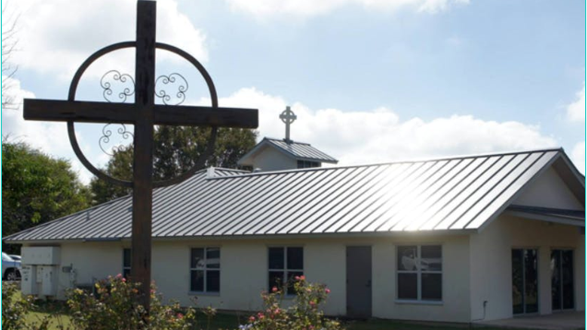
The Church
Board of Appeals
February 29, 2024

Slide 2
Background of The Church
Pastor Mills, pastor of The Church, is here today to appeal her most recent fire and life safety inspection requiring that an exhaust hood system be installed in accordance with the Florida Fire Prevention Code and NFPA 96.
Mixed Occupancy
  Existing Assembly – Occupant load: 54
  Existing Day Care Occupancy

Slide 3
Overview
Definition
  Mixed Occupancy
  Assembly Occupancy
Supporting Documents
  Florida Fire Prevention Code (FFPC)
  National Fire Protection Association (NFPA) 96
Closing
Questions

Slide 4
Definition
Mixed Occupancy
FFPC 101:3.3.198.10 - A multiple occupancy where the occupancies are intermingled.
Assembly
FFPC 101: 3.3.198.2 - An occupancy (1) used for the gathering of 50 or more persons for deliberation, worship, entertainment, eating, drinking, amusement, awaiting transportation, or similar uses; or (2) used for a special amusement building, regardless of occupant load.

Slide 5

Supporting Documents
Florida Fire Prevention Code (FFPC) - A set of fire code provisions that includes the Florida-specific edition of NFPA 101 and NFPA 1. The FFPC is adopted by the State Fire Marshal at three-year intervals. This complex set of fire code provisions are enforced by the local fire official within each county, municipality, and special fire district in the state.

Slide 6


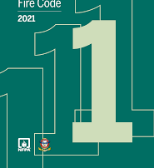
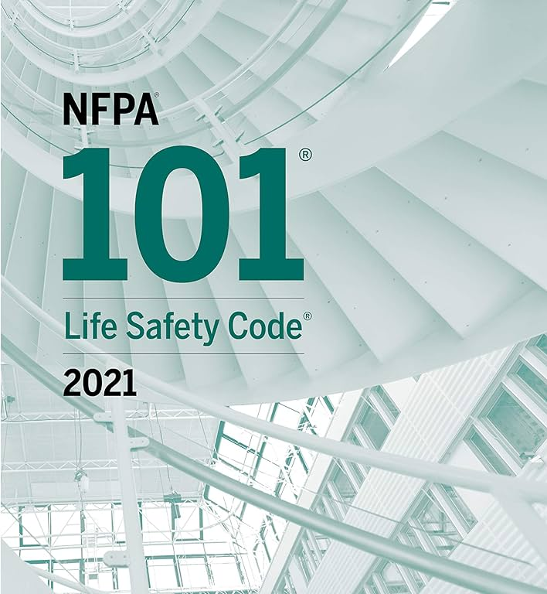
Supporting Documents
NFPA 101 - Life Safety Code - A set of guidelines for the design, construction, and maintenance of buildings. Covers life safety in both new and existing structures. The code is based on building construction, protection, and occupancy features.
NFPA 1 – Fire Code - A set of guidelines and regulations for fire safety in buildings and other structures.

Slide 7
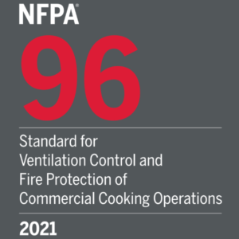
Supporting Documents
NFPA 96 - Standard for Ventilation Control and Fire Protection of Commercial Cooking Operations
  Provides preventive and operative fire safety requirements intended to reduce the potential fire hazard of both public and private commercial cooking operations.

Slide 8
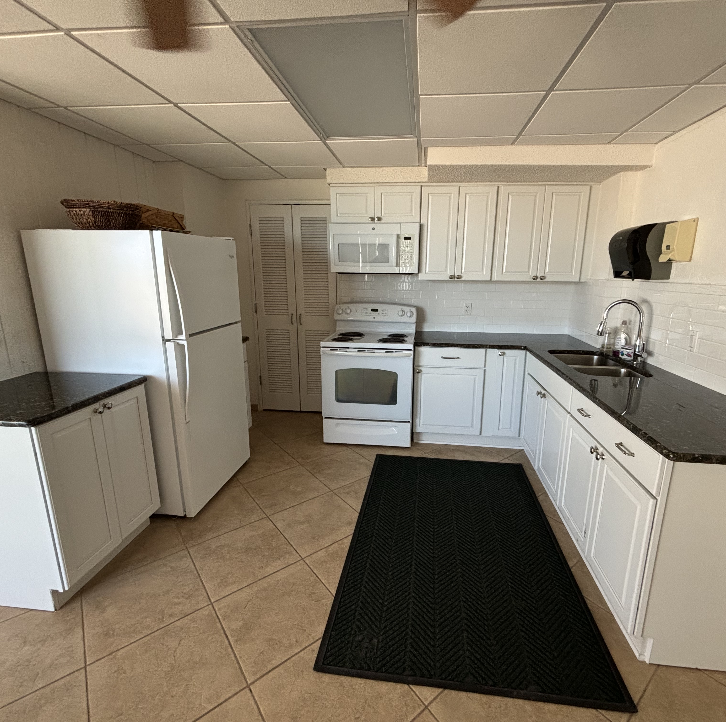
Supporting Documents
The requirements for a commercial exhaust hood system:
  FFPC 101: 13.3.2.2. - Existing Assembly - Cooking equipment shall be protected in accordance with 9.2.3, unless the cooking equipment is one of the following types:
    Outdoor equipment
    Portable equipment not flue-connected
    Equipment used only for food warming
  FFPC 101: 9.2.3 – Where required by another section of this Code, commercial cooking operations shall be protected in accordance with NFPA 96 unless such installations are approved existing installations, which shall be permitted to be continued in service.

Slide 9
Approved Installations
FFPC 101:3.2.1* Approved – Acceptable to the authority having jurisdiction.
FFPC A.101:3.2.1 - The National Fire Protection Association does not approve, inspect, or certify any installations, procedures, equipment, or materials; nor does it approve or evaluate testing laboratories. In determining the acceptability of installations, procedures, equipment, or materials, the authority having jurisdiction may base acceptance on compliance with NFPA or other appropriate standards.

Slide 10
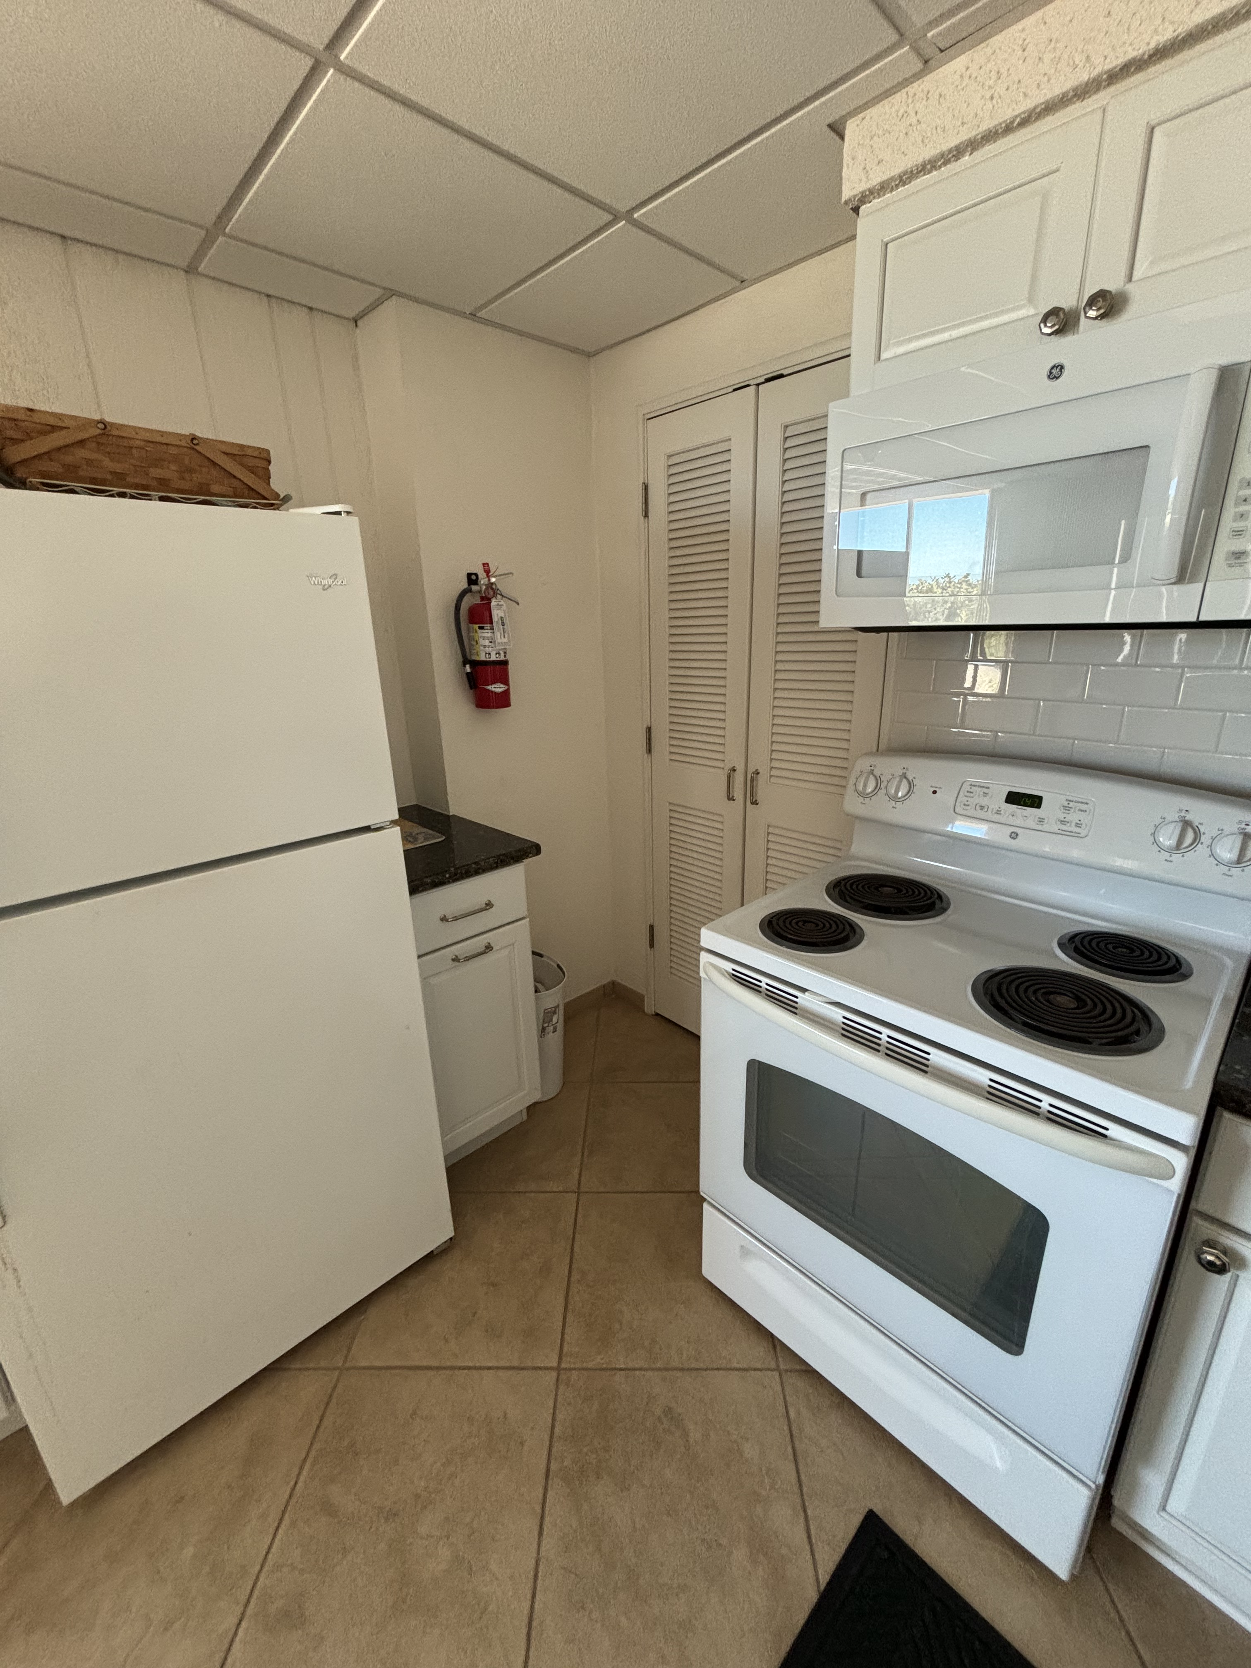
Supporting Documents, cont.
NFPA 96: 1.1.5 – Administration – This standard shall not apply where all of the following are met:
  Only residential equipment is used.
  Fire extinguishers are located in all kitchen areas in accordance with NFPA 10.
  The facility is not an assembly occupancy.
  The authority having jurisdiction has approved the installation.
NFPA 96: 4.1.1 - Cooking equipment used in processes producing smoke or grease-laden vapors shall be equipped with an exhaust system that complies with all equipment and performance requirements of this standard.

Slide 11
Closing
Florida Fire Prevention Code (FFPC), 8th Edition
NFPA 96, Standard for Ventilation Control and Fire Protection of Commercial Cooking Operations
The need for a commercial exhaust hood system in accordance with NFPA 96 is required OR the stove shall be removed.
Witness

Slide 12
Questions?

