Slide 1
Appeal for "The Church"
Unfair Enforcement of Commercial Exhaust Hood System
By: Pastor Lisa Mills
2/29/24

Slide 2
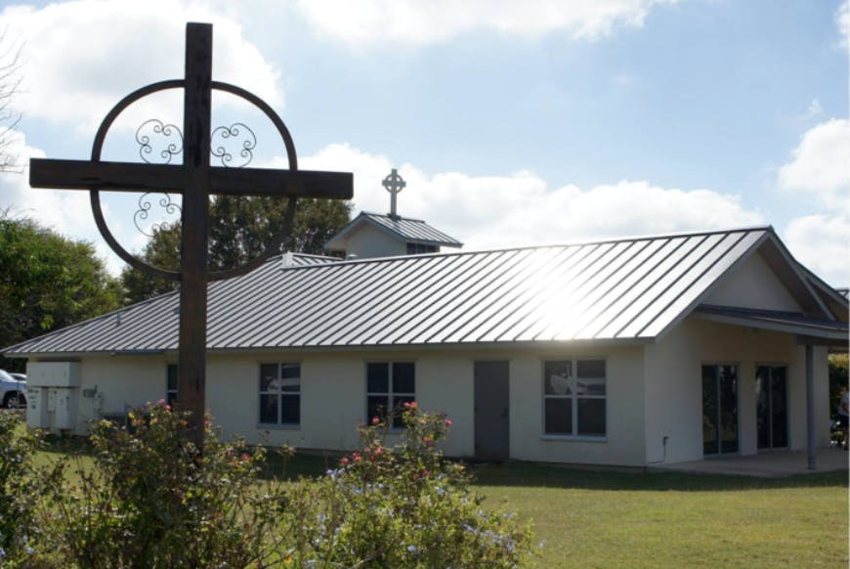
Background and History
Built to code in 2013
Occupancy load of 54
Has an approved fire alarm system
Cooking appliances used only once a month.
The attached daycare uses kitchen Monday-Friday for warming lunches and bottles.

Slide 3
Introduction
Enforced installation of a commercial exhaust hood system at "The Church."
Reasons for the appeal.

Slide 4
Inspection History
Date | Status
February 19, 2021 | Passed
January 26, 2022 | Passed
February 7, 2023 | Passed
January 31, 2024 | Failed
What changed?

Slide 5
Lack of Historical Requirement
The residential equipment has been in use for 11 years without violation notification.
Requesting grandfathered status due to historical compliance.

Slide 6
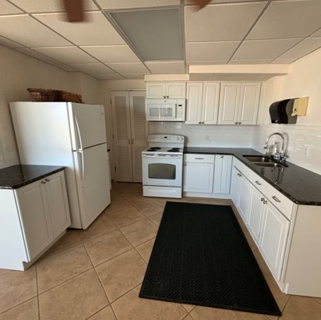
Kitchen Usage
Monthly pancake breakfast
Daycare uses for warming lunches and bottles
Cleaned after each use and very well maintained
The occasional nature of use minimizes potential fire risk.

Slide 7
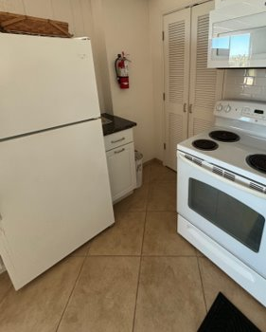
Equipment Used
All residential, not commercial-grade
All electric
Well maintained and cleaned

Slide 8
Community Impact
Community Building and Social Bonding
Gathering Point:
  The pancake breakfast serves as a regular gathering point for community members, fostering a sense of belonging and unity.
Social Interactions:
  Provides an informal setting for residents to interact, share stories, and build meaningful connections with one another.
  Fundraising for Community Initiatives
  Support for Local Causes:
    Often, the pancake breakfast serves as a fundraising event, with proceeds directed towards the community, such as supporting schools, charities, or local development projects.
  Financial Assistance:
    The funds generated contribute to the financial well-being of the community and enable the church to continue its charitable work.

Slide 9
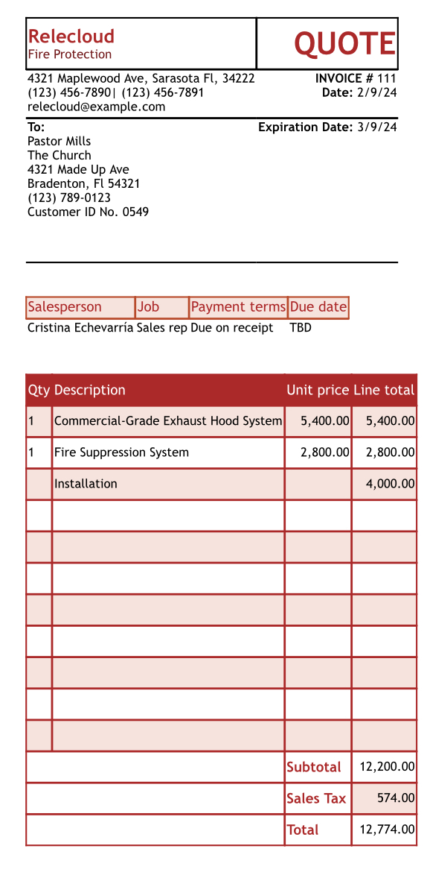
Financial Impact
Finacial burden on the church for an unexpected requirement.
Potential impacts on church programs.
Potential impacts on the daycare.

Slide 10
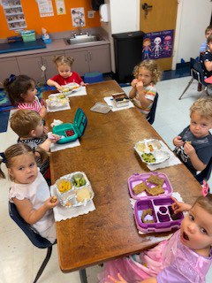
Daycare Operations
Operates Independently
Uses the kitchen for warming bottles and preparing lunch only
Relies on the kitchen to operate daily

Slide 11
Safety Measures Already in Place
Approved fire alarm
Certified fire extinguishers
Emergency lights
Emergency exit signs

Slide 12
Conclusion
In conclusion, I respectfully request a reassessment of the enforcement of a commercial exhaust hood system at "The Church" based on the compelling points presented in this appeal.
Throughout this presentation, we have demonstrated:
Historical Compliance
  Consistent passage of inspections over 11 years.
  No prior mention of exhaust hood system requirement.
Residential Equipment Usage
  Kitchen equipment is residential, not commercial-grade.
  Occasional use for monthly member breakfasts.
Daycare Facility Distinction
  Daycare is unaffiliated, uses kitchen minimally.
  Activities align with warming bottles and preparing lunches.

Slide 13

Conclusion, cont.
Code Interpretation Challenge​
  Question the sudden imposition without prior notification.​
  Past interpretations with no violations cited.​
Financial Impact​
  Proposed system imposes a significant financial burden.​
  Potential impact on essential church programs and services.​
Requested Remedy​
  Propose reassessment considering historical compliance.​
  Emphasize the residential nature of equipment and limited risk.
  The already existing fire protection systems.

Slide 14

Questions?

