Slide 1


Appeal Against Fire Code Deficiency report
Jimbo’s Gumbo and Grill
Jim Beau Jr.
1234 Made Up Avenue
Bradenton, Fl 54321

Slide 2
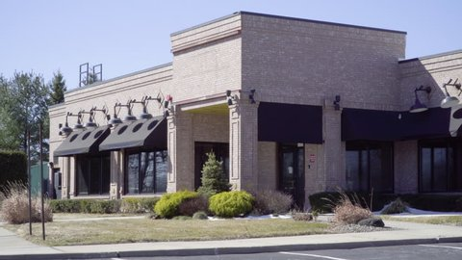
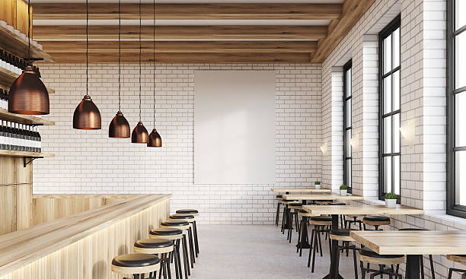
Background and history
Family-owned and operated restaurant
Remodeled to code and opened in 2009
Approximately 9,200 square feet
Assembly
Approved monitored fire alarm system
Bi-Annually certified exhaust hood system with suppression
Certified fire extinguishers (ABC & Class K)

Slide 3
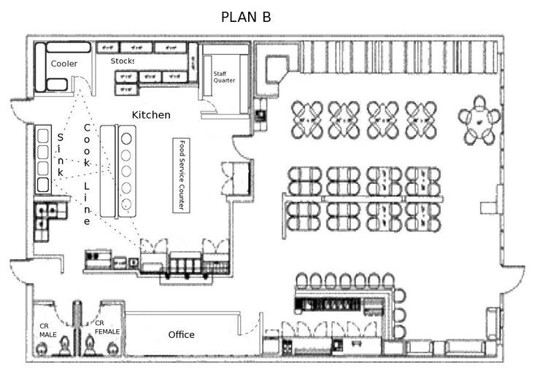
Proposed addition
20’x30’
Addition
Added 600 sq ft
Occupancy load of 164

Slide 4
Grounds for appeal
Misinterpretation of the code
  Florida fire prevention code (FFPC) does not mandate a fire sprinkler system
    FFPC 13.3.5.1 “Where the occupant load exceeds 300 the following assembly occupancies shall be protected throughout be an approved supervised automatic sprinkler system in accordance with 9.7.1.1”
      Dance halls
      Discotheques
      Nightclubs
      Assembly occupancy with festival seating

Slide 5
Grounds for appeal
Date | Status
August 19, 2021 | Passed
July 20, 2022 | Passed
September 9, 2023 | Passed
Historical Compliance without a fire sprinkler system
Annual fire and life safety inspection

Slide 6
Justifications
Compliance with fire safety regulations
  Operated for 15 years without a fire sprinkler system
  Compliant with Florida Fire Prevention Code
Public safety measures
  Monitored fire alarm system (Not Required)
  Annually certified exhaust hood system with suppression
  Certified fire extinguishers (ABC & Class K)
Proposed addition not significantly altered fire risk

Slide 7
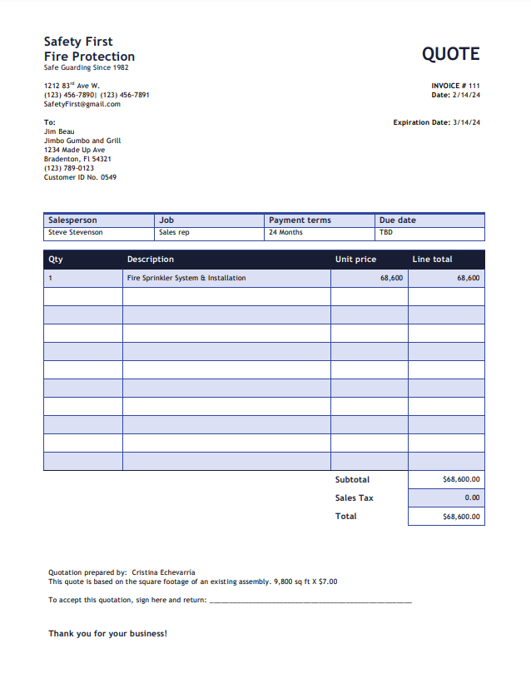
Extreme expense considerations
Installation Cost
Business Disruption
Maintenance Costs
The financial strain is extreme on a small business

Slide 8
Closing
Historical compliance
Compliant with the state fire code
Same occupant load
Witnesses

Slide 9

Question?

